Slide 1
THE ARMOR OF VICTORY
Exposing the Strategy of the Evil One
Notes:
Session 1

Slide 2
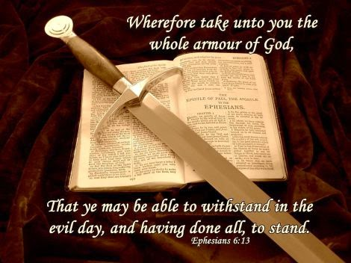
The WHOLE Armor of God
Notes:
Session 1

Slide 3
Ephesians 6:10
From now on, my brothers, be strong in our Lord and in the immensity of his power
Notes:
Session 1

Slide 4
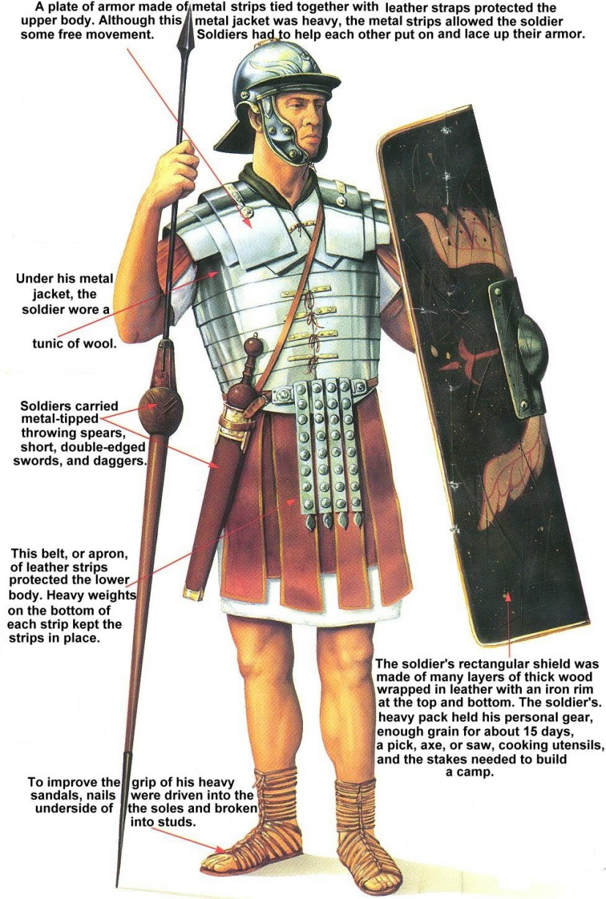
Dressed for Success
Notes:
Session 1

Slide 5
Put On
The new man (Eph 4:24) =
The Lord Jesus Christ (Rom 13:14) =
Armor of light (Rom 13:12) =
Armor of God (Eph 6:11,13)
Notes:
Session 1

Slide 6
The Armor of God Overview
 |  | ACTION WE TAKE | PIECE OF ARMOR | SPIRITUAL CLOTHING | AGAINST PRINCIPALITY
A | Lord | Gird your loins | belt | of truth (faithfulness) | Beelzebub
B | Jesus | Put on | breastplate | of justification | Devil
C | Christ | Bind on | sandals | of the firm platform of the gospel of peace | Dragon
C | Christ | Raise up | shield | of the name of Jesus Christ | Satan
B | Jesus | Set on your head | helmet | of redemption | Belial
A | Lord | Take hold of, clasp | sword | of the Spirit, the living Word | Serpent
Notes:
Session 2

Slide 7
Ephesian 6:11-13
and put on the whole armor of God, so that you may be able to stand against the tactics of the Accuser,
because your struggle is not with flesh and blood, but with rulers and with authorities and with the possessors of this dark world and with the evil spirits that are under heaven.
Because of this, put on the whole armor of God, so that you will be able to engage the Evil [one] and, being prepared in everything, you will stand firm.
Notes:
Session 2

Slide 8
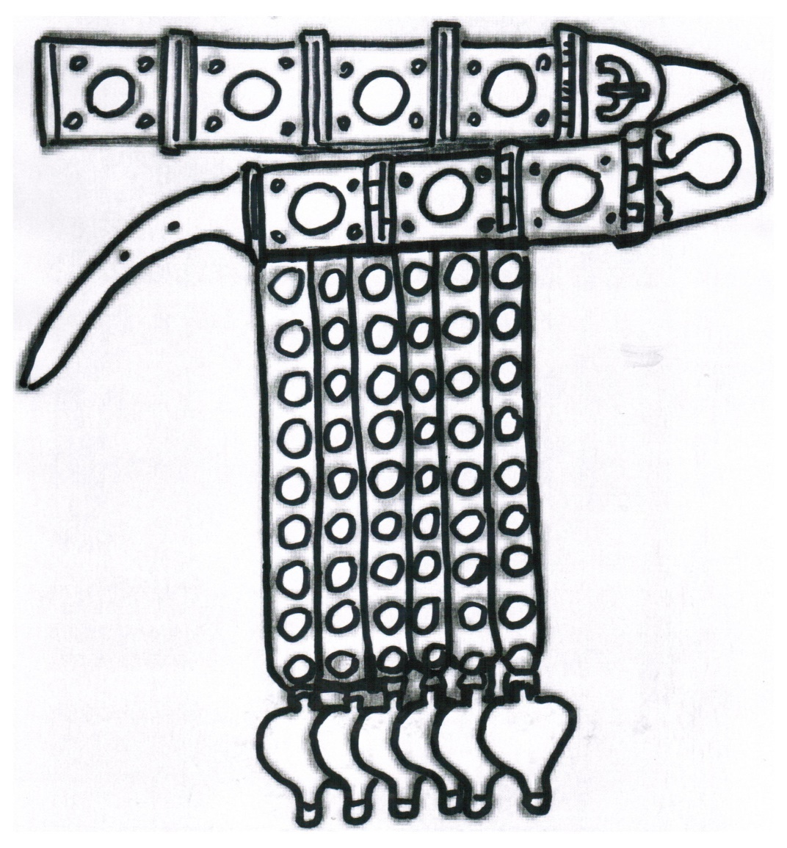
The Belt of Truth
Notes:
Session 2

Slide 9
ACTION WE TAKE | PIECE OF ARMOR | SPIRITUAL CLOTHING | AGAINST PRINCIPALITY
Gird your loins (base decisions on) | belt | of truth (faithfulness) | Beelzebub

Slide 10
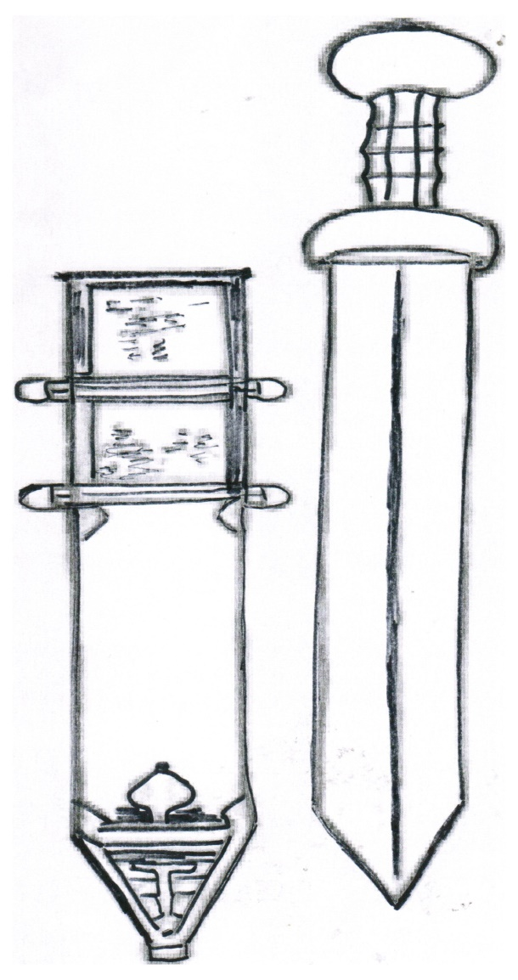
The Sword of the Spirit
Notes:
Session 2

Slide 11
ACTION WE TAKE | PIECE OF ARMOR | SPIRITUAL CLOTHING | AGAINST PRINCIPALITY
Take hold of, clasp (seize) | sword | of the Spirit, the living Word | Serpent

Slide 12
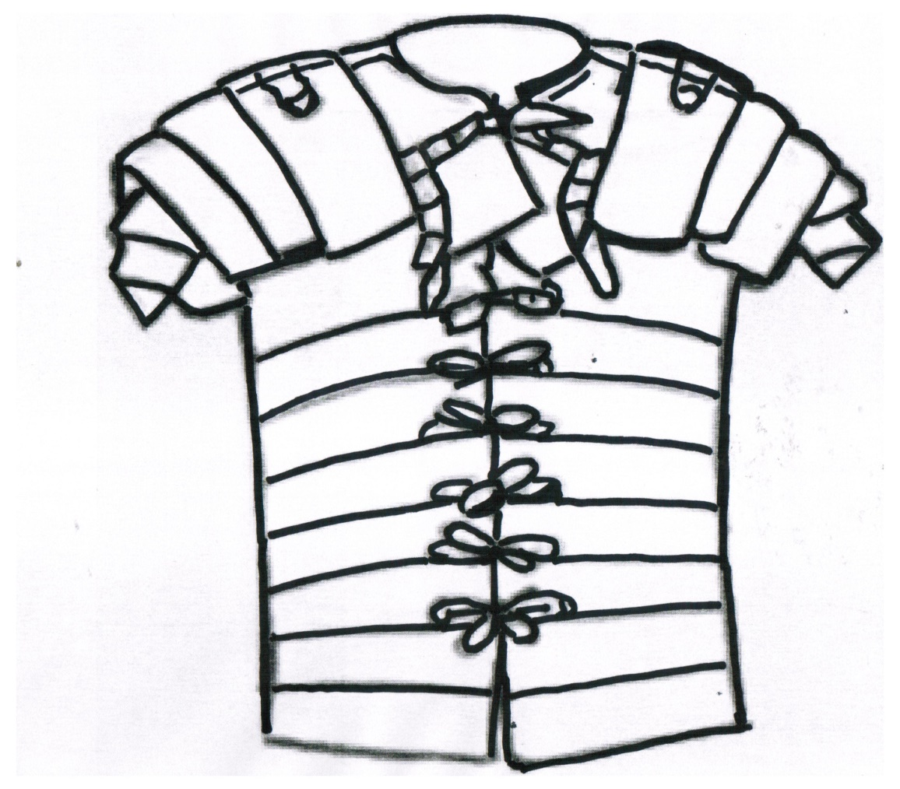
The Breastplate of Justification
Notes:
Session 3

Slide 13
ACTION WE TAKE | PIECE OF ARMOR | SPIRITUAL CLOTHING | AGAINST PRINCIPALITY
Put on (cover your heart) | breastplate | of justification | Devil

Slide 14
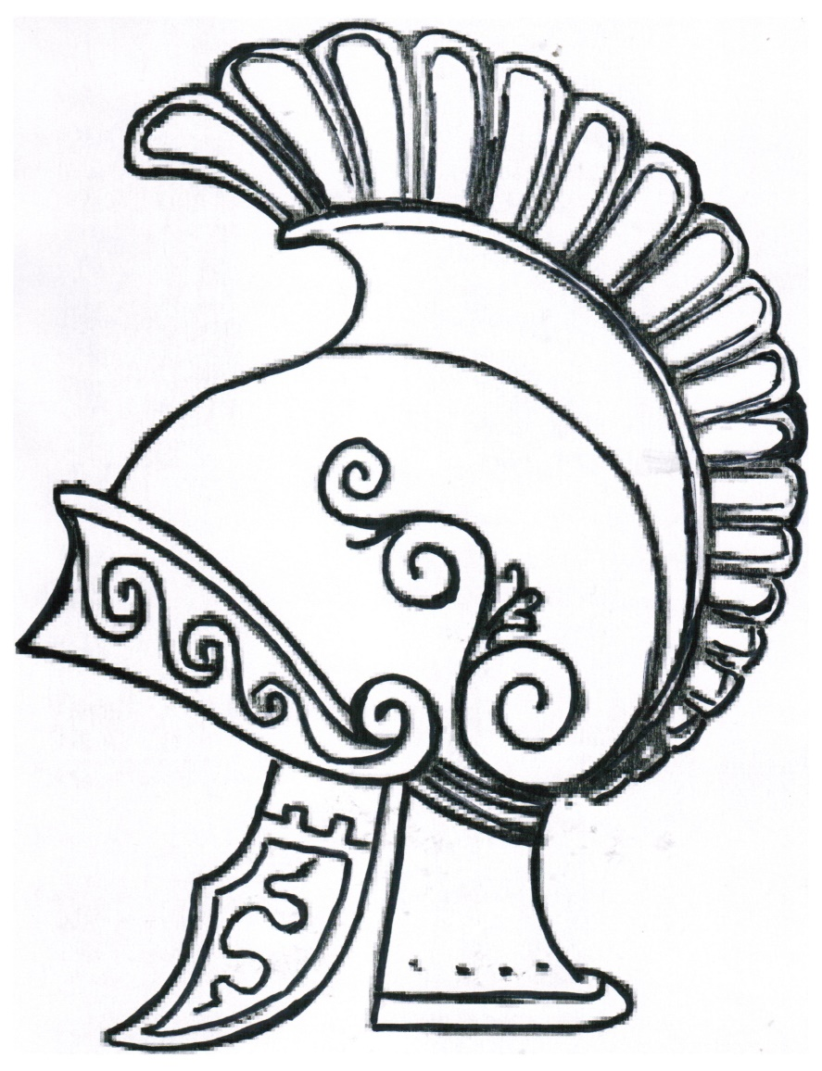
The Helmet of Redemption
Notes:
Session 3

Slide 15
ACTION WE TAKE | PIECE OF ARMOR | SPIRITUAL CLOTHING | AGAINST PRINCIPALITY
Set on your head (surround mind) | helmet | of redemption | Belial

Slide 16
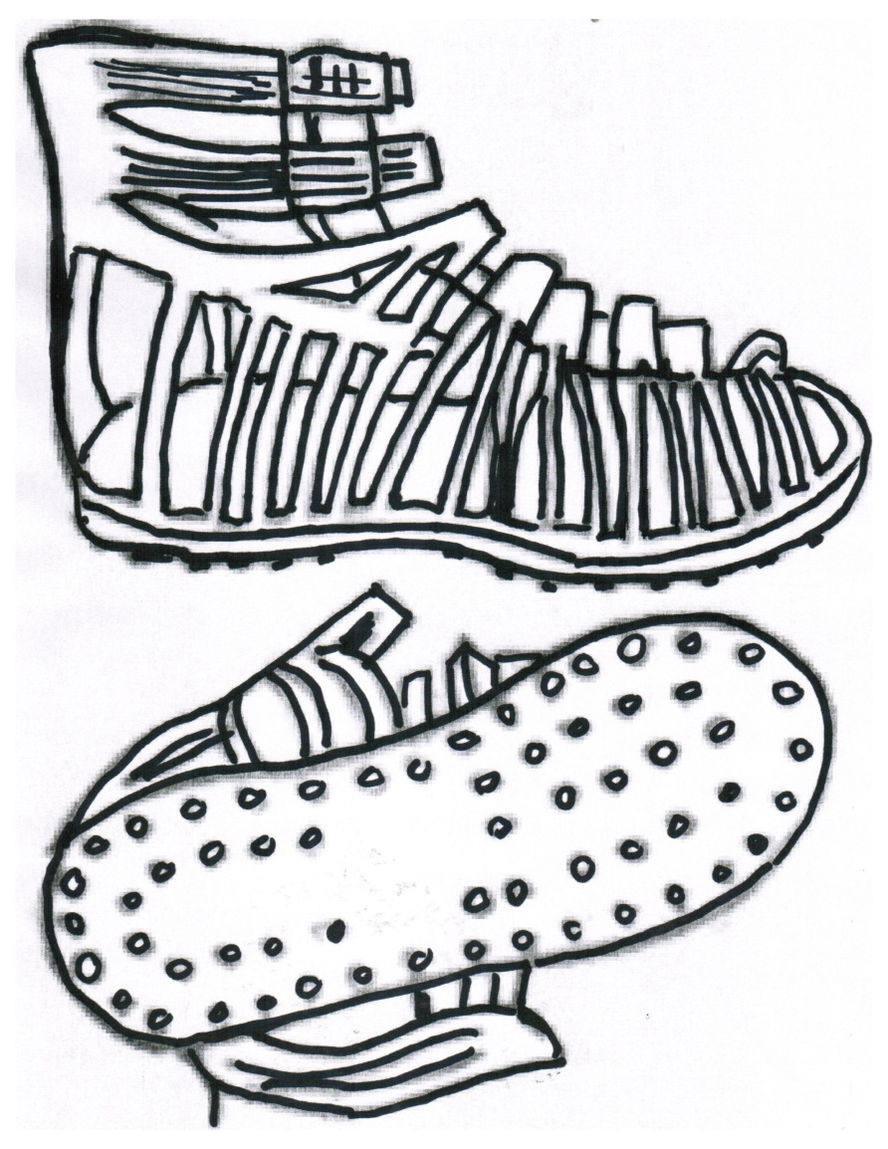
The Sandals of the Gospel
Notes:
Session 4

Slide 17
ACTION WE TAKE | PIECE OF ARMOR | SPIRITUAL CLOTHING | AGAINST PRINCIPALITY
Bind on (prepare your feet to walk) | sandals | of the firm platform of the gospel of peace | Dragon

Slide 18
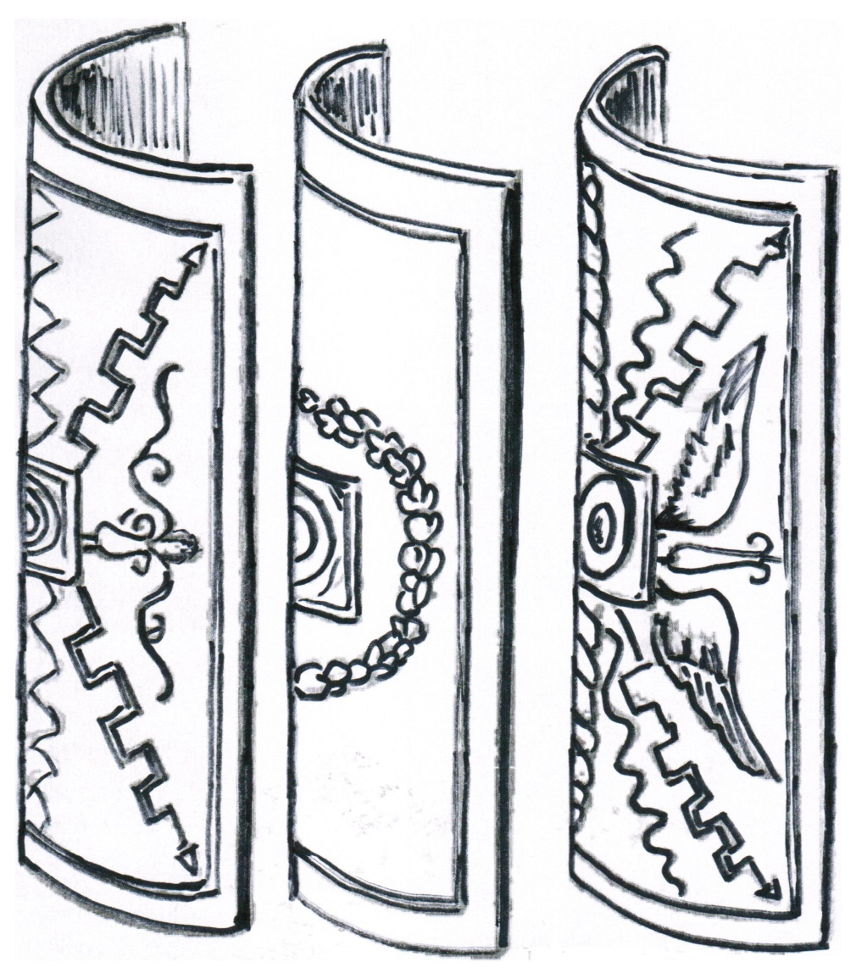
The Shield of the Name of Jesus Christ
Notes:
Session 4

Slide 19
ACTION WE TAKE | PIECE OF ARMOR | SPIRITUAL CLOTHING | AGAINST PRINCIPALITY
Raise up (utilize) | shield | of the name of Jesus Christ | Satan

Slide 20
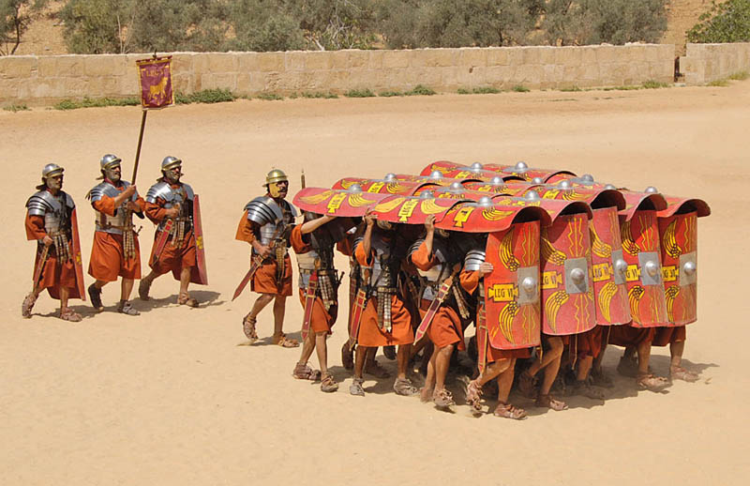
“Turtle” Formation
Notes:
Session 4

Slide 21
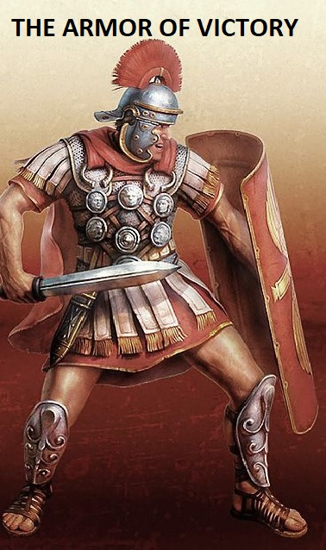
Battle Stance
Notes:
Session 4

Slide 22
Strategy of the Evil One
Principalities | Devices (Purposes) | Tactics (Methods) | Implementation of Weapons
Beelzebub | Control, usurp the Lordship of Jesus Christ | “Dominate and poison” | Corrupt words, propaganda, false teaching
Devil | Slander, devour | “Cut and ensnare” | Accusation, guilt, rejection
Dragon | Divide, destroy | “Twist and separate” | Pride, offense, jealousy, intimidation, stubbornness
Satan | Torment, oppress | “Shock and freeze” | Fear, sickness, catastrophes
Belial | Captivate, swallow | “Corrupt and distress” | Unworthiness, addictions, perversity
Serpent | Deceive, blind | “Dazzle and blind” | Counterfeit religion, lies, occult, witchcraft
Notes:
Session 5

Slide 23
Summary of Armor
Piece of armor | How armor works
Girdle | God’s faithfulness to his Word is the source of our strength.
Breastplate | God’s legal requirement for justice is paid for in Jesus Christ and protects the heart and vital organs.
Sandals | Everyone has a place in the body of Christ, which brings peace and is a firm platform to stand upon.
Shield | The name of Jesus Christ and the nine manifestations of the Spirit extinguish specific attacks.
Helmet | Redemption now and in the future protects our mind.
Sword | The living Word, “it is written,” can be used in any situation to separate truth from lies.
Notes:
Session 5

